Slide 1

o
e
a
e
r
h
s
S
f
S
l
u
f
e
h
Notes:
This template is for educational, non-commercial purposes only. For more free game templates like this one, visit https://www.taysteachingtoolkit.com

Slide 2


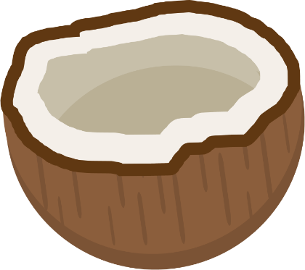

A pearl is put in a coconut.

Slide 3
Watch that coconut carefully.

Slide 4
The coconuts will shuffle.

Slide 5
Guess where the pearl is...

Slide 6
dog
cat
bird
...by writing a word or sentence.
Notes:
TEACHER’S NOTES:
Idea for a reading game variation: After the coconuts shuffle, go through each coconut one by one. As you go through each coconut, have the students who think that coconut has the pearl read the word/sentence associated with the coconut together.
Idea for a speaking game variation: Use pictures instead of words for the reading game variation.
For both of these variations, delete the timer music on the game slides (more details in the “Notes” sections of the slides).
If using a variation of the game, adjust the rules on this slide accordingly (i.e., replace “writing” with “reading” or “saying.”)

Slide 7
Find the pearl and you win points!

Slide 8


= 1 point
= 3 points
= 5 points
Notes:
TEACHER’S NOTES:
The color of the pearls indicate how difficult it will be to figure out which coconut has the pearl.
White = Easy
Pink = Intermediate
Gold = Hard
Feel free to adjust the point values as needed.

Slide 9
The student with the most points at the end of the game wins!

Slide 10
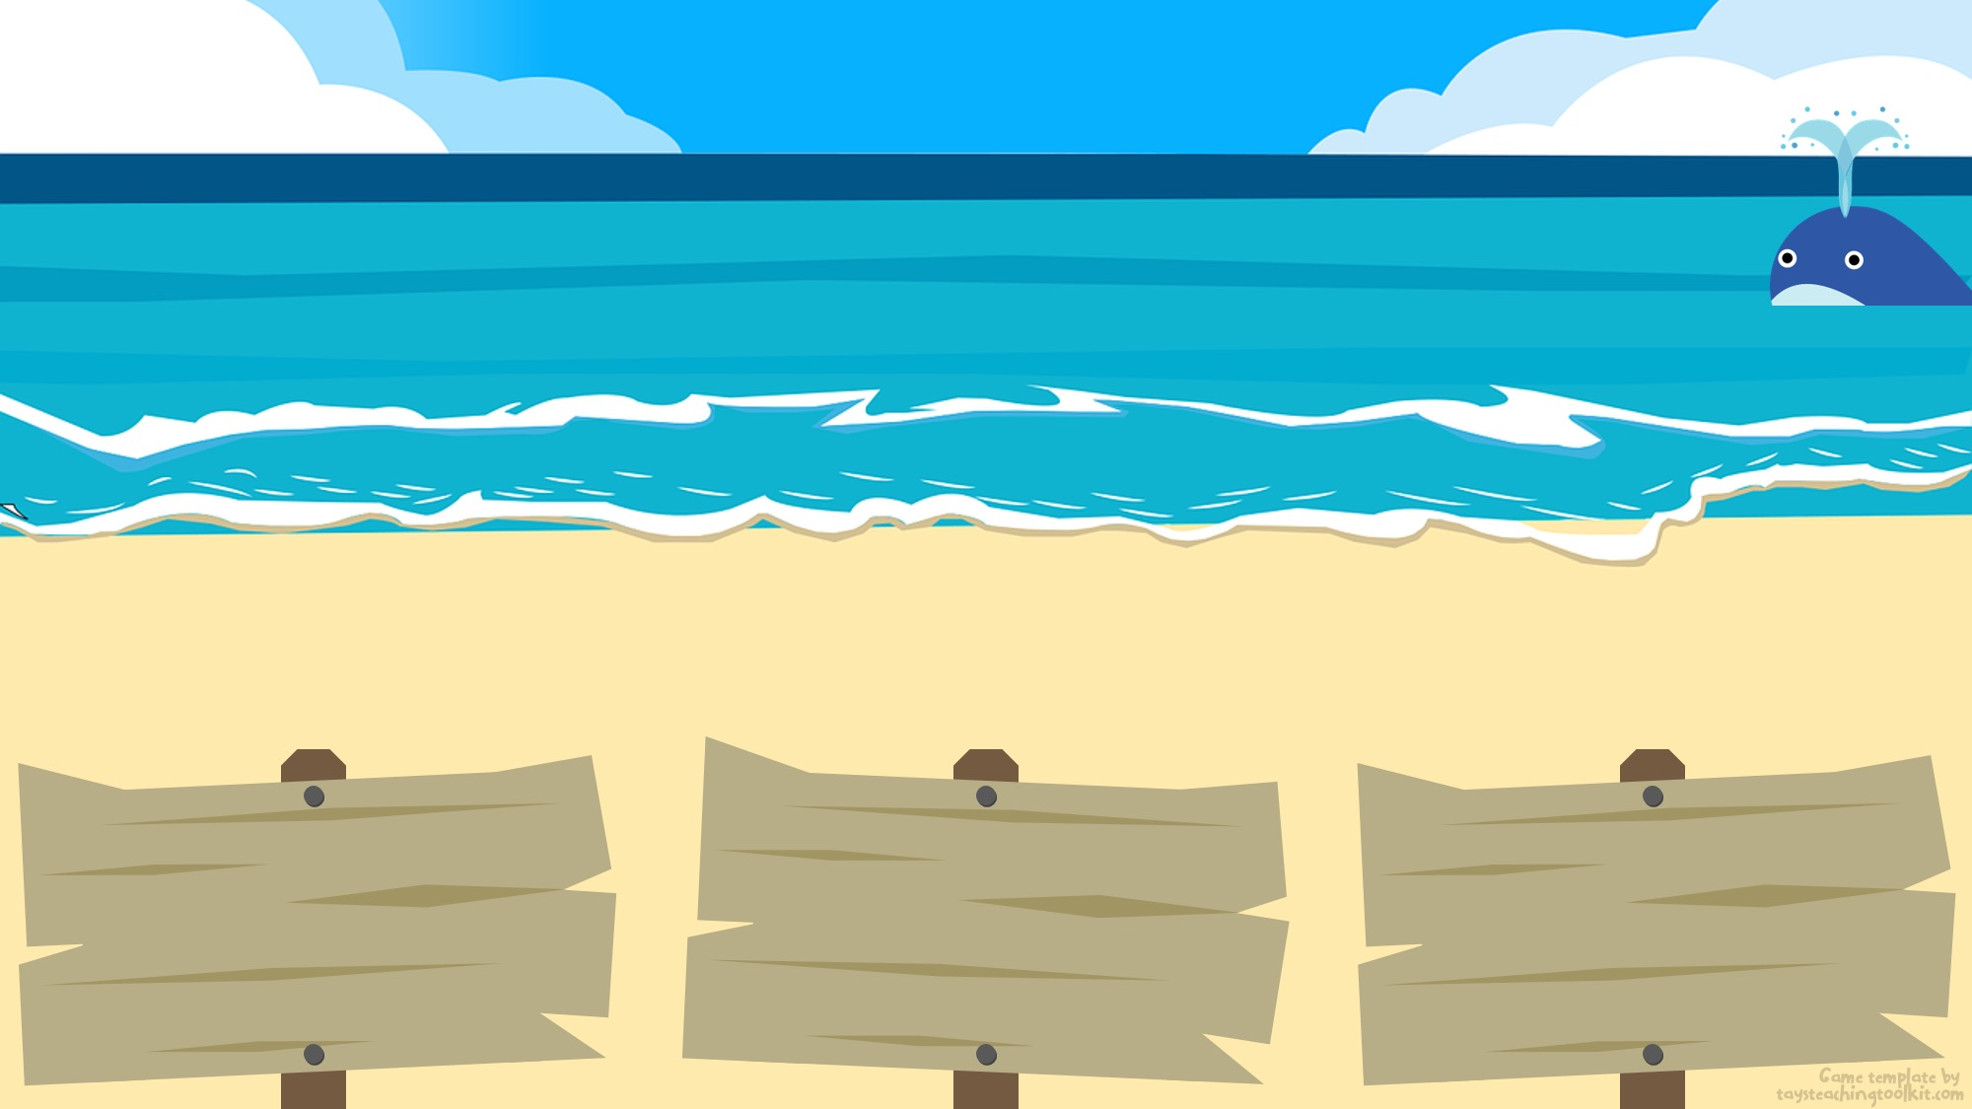

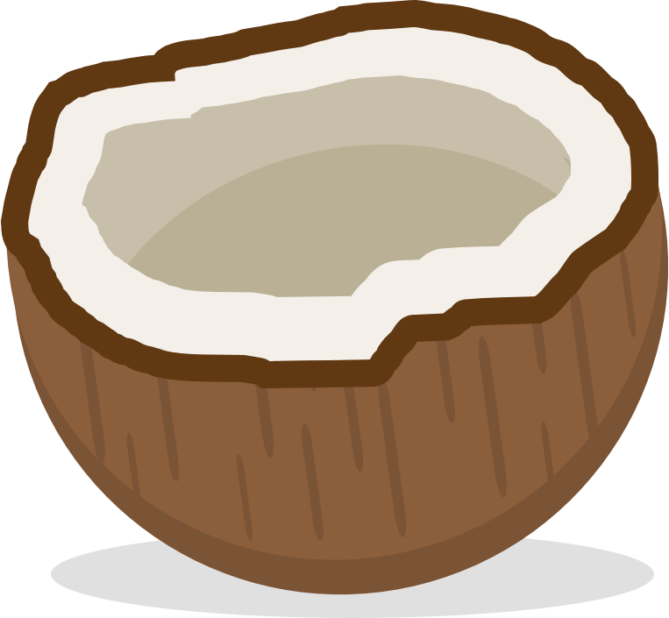

1
First part of the sentence here
(delete if not needed)
word, sentence, or picture here
word, sentence, or picture here
word, sentence, or picture here
Notes:
TEACHER’S NOTES:
Coconut with the pearl: #1
Click to drop the pearl into the coconut.
Click again to shuffle the coconuts.
Music will start playing. This indicates how long students have to write their answer (~38s).
Once the music stops, time is up. However, feel free to give students more time if needed or delete the music completely by deleting “Timer Music” from the animations panel.
Click to reveal the answer.
Click again to go to the next slide.
NOTE: To save space on the signs in order to keep the text big and legible, I have included an extra textbox at the top of the slide. This is especially useful when students need to write a full sentence and the first part of the sentence is the same for each answer. For example, the sentence they are practicing could be, “Where is the (place name)?” You can type “Where is the…” in the space at the top of the slide and type “bank,” “hospital,” and ”library” for the answers on the three signs. However, feel free to delete that textbox if it’s not needed.

Slide 11
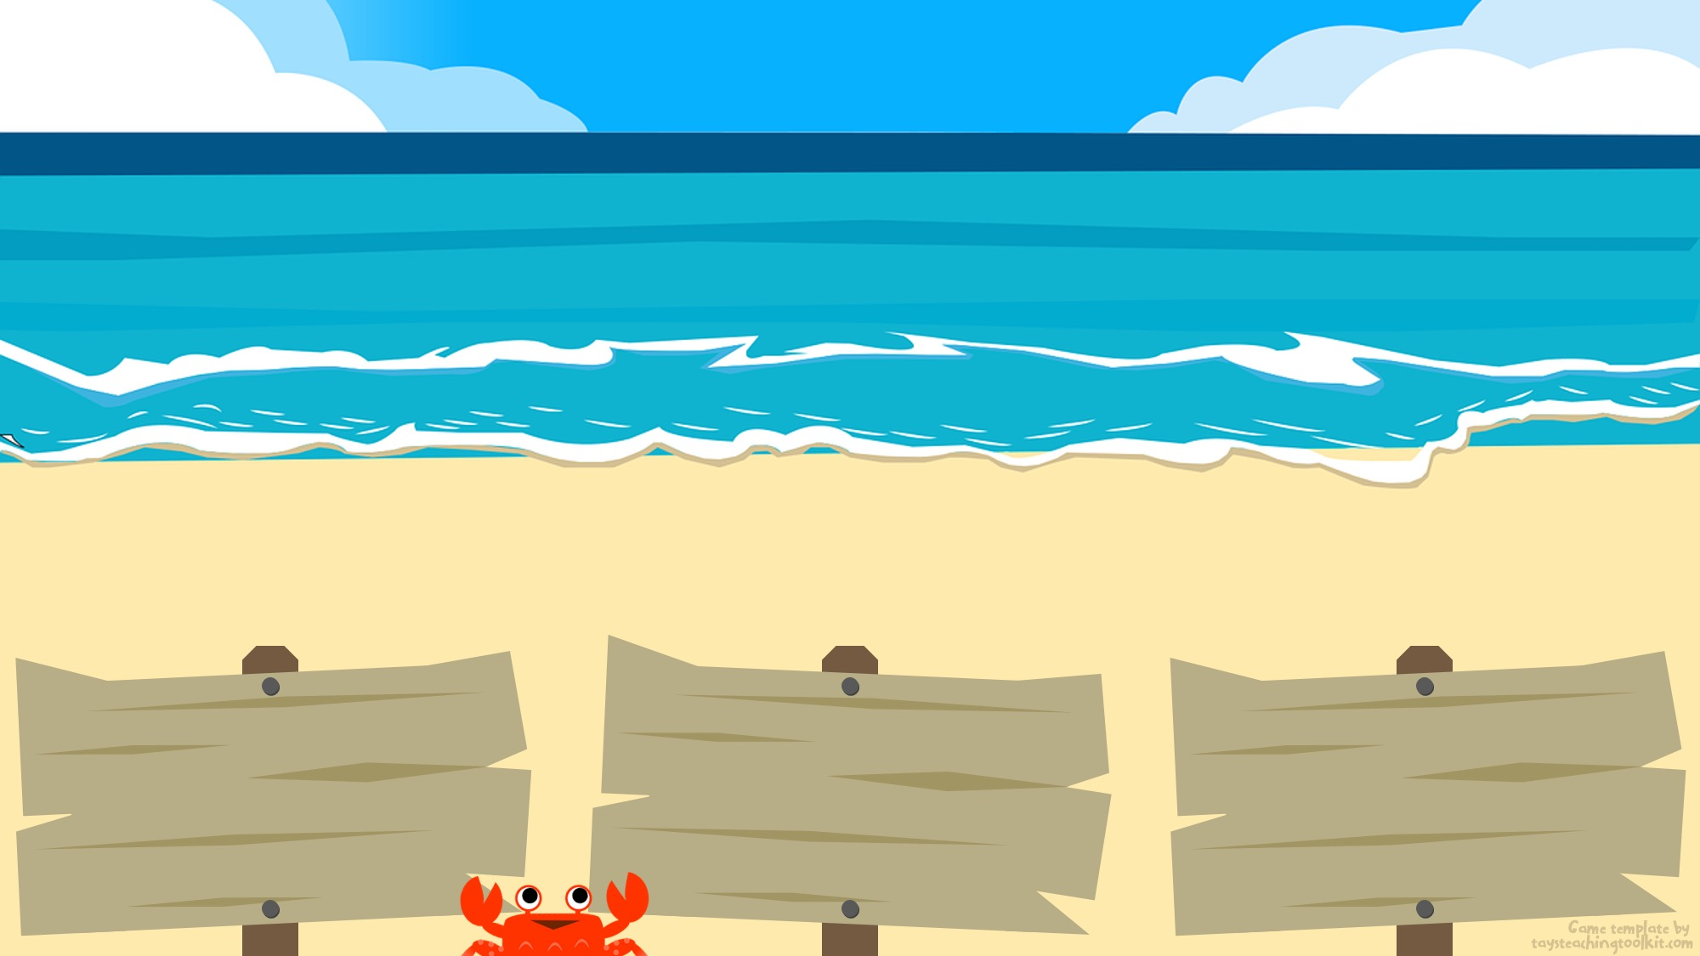
2
First part of the sentence here
(delete if not needed)
word, sentence, or picture here
word, sentence, or picture here
word, sentence, or picture here
Notes:
TEACHER’S NOTES:
Coconut with the pearl: #2
Click to drop the pearl into the coconut.
Click again to shuffle the coconuts.
Music will start playing. This indicates how long students have to write their answer (~38s).
Once the music stops, time is up. However, feel free to give students more time if needed or delete the music completely by deleting “Timer Music” from the animations panel.
Click to reveal the answer.
Click again to go to the next slide.
NOTE: To save space on the signs in order to keep the text big and legible, I have included an extra textbox at the top of the slide. This is especially useful when students need to write a full sentence and the first part of the sentence is the same for each answer. For example, the sentence they are practicing could be, “Where is the (place name)?” You can type “Where is the…” in the space at the top of the slide and type “bank,” “hospital,” and ”library” for the answers on the three signs. However, feel free to delete that textbox if it’s not needed.

Slide 12
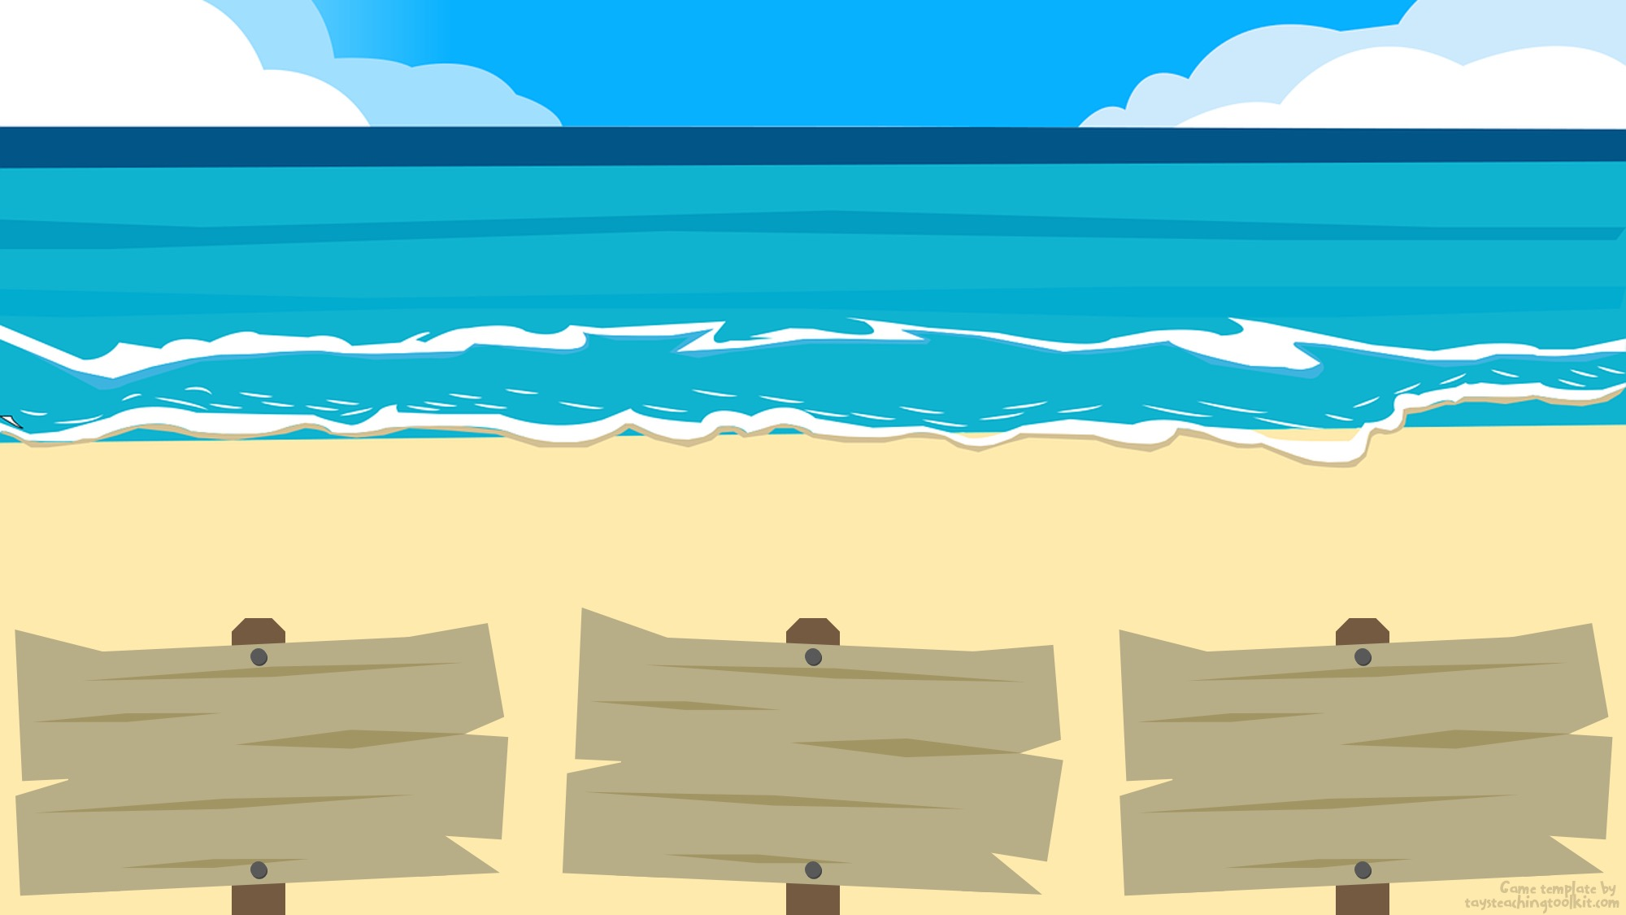
3
First part of the sentence here
(delete if not needed)
word, sentence, or picture here
word, sentence, or picture here
word, sentence, or picture here
Notes:
TEACHER’S NOTES:
Coconut with the pearl: #2
Click to drop the pearl into the coconut.
Click again to shuffle the coconuts.
Music will start playing. This indicates how long students have to write their answer (~38s).
Once the music stops, time is up. However, feel free to give students more time if needed or delete the music completely by deleting “Timer Music” from the animations panel.
Click to reveal the answer.
Click again to go to the next slide.
NOTE: To save space on the signs in order to keep the text big and legible, I have included an extra textbox at the top of the slide. This is especially useful when students need to write a full sentence and the first part of the sentence is the same for each answer. For example, the sentence they are practicing could be, “Where is the (place name)?” You can type “Where is the…” in the space at the top of the slide and type “bank,” “hospital,” and ”library” for the answers on the three signs. However, feel free to delete that textbox if it’s not needed.

Slide 13
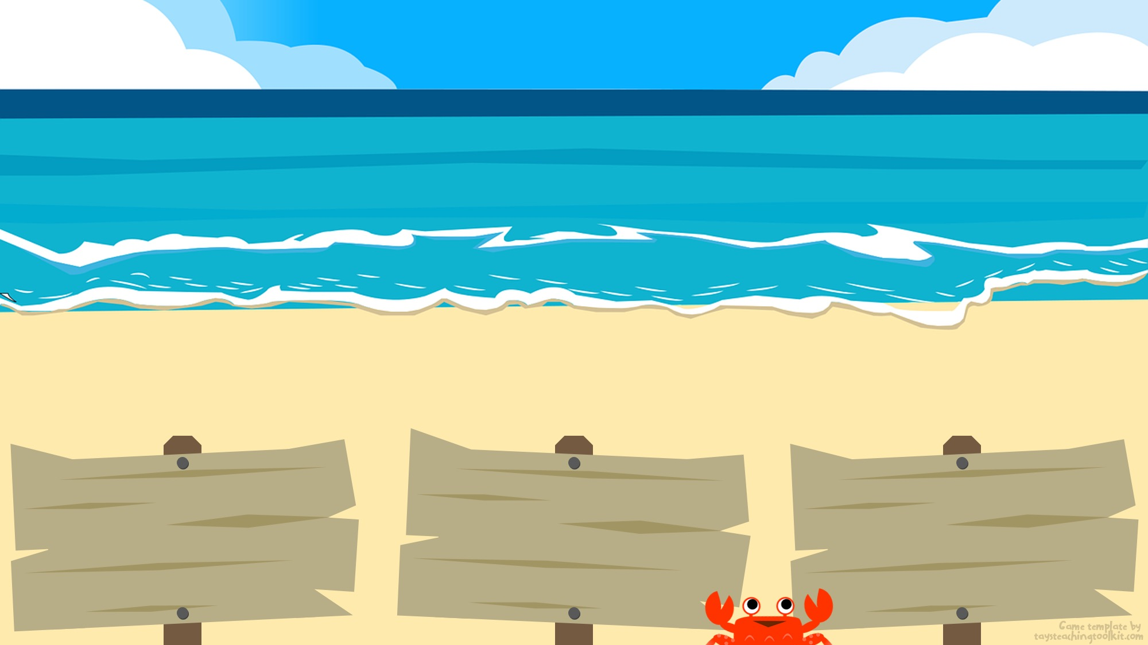
4
First part of the sentence here
(delete if not needed)
word, sentence, or picture here
word, sentence, or picture here
word, sentence, or picture here
Notes:
TEACHER’S NOTES:
Coconut with the pearl: #3
Click to drop the pearl into the coconut.
Click again to shuffle the coconuts.
Music will start playing. This indicates how long students have to write their answer (~38s).
Once the music stops, time is up. However, feel free to give students more time if needed or delete the music completely by deleting “Timer Music” from the animations panel.
Click to reveal the answer.
Click again to go to the next slide.
NOTE: To save space on the signs in order to keep the text big and legible, I have included an extra textbox at the top of the slide. This is especially useful when students need to write a full sentence and the first part of the sentence is the same for each answer. For example, the sentence they are practicing could be, “Where is the (place name)?” You can type “Where is the…” in the space at the top of the slide and type “bank,” “hospital,” and ”library” for the answers on the three signs. However, feel free to delete that textbox if it’s not needed.

Slide 14
5
First part of the sentence here
(delete if not needed)
word, sentence, or picture here
word, sentence, or picture here
word, sentence, or picture here
Notes:
TEACHER’S NOTES:
Coconut with the pearl: #3
Click to drop the pearl into the coconut.
Click again to shuffle the coconuts.
Music will start playing. This indicates how long students have to write their answer (~38s).
Once the music stops, time is up. However, feel free to give students more time if needed or delete the music completely by deleting “Timer Music” from the animations panel.
Click to reveal the answer.
Click again to go to the next slide.
NOTE: To save space on the signs in order to keep the text big and legible, I have included an extra textbox at the top of the slide. This is especially useful when students need to write a full sentence and the first part of the sentence is the same for each answer. For example, the sentence they are practicing could be, “Where is the (place name)?” You can type “Where is the…” in the space at the top of the slide and type “bank,” “hospital,” and ”library” for the answers on the three signs. However, feel free to delete that textbox if it’s not needed.

Slide 15
6
First part of the sentence here
(delete if not needed)
word, sentence, or picture here
word, sentence, or picture here
word, sentence, or picture here
Notes:
TEACHER’S NOTES:
Coconut with the pearl: #1
Click to drop the pearl into the coconut.
Click again to shuffle the coconuts.
Music will start playing. This indicates how long students have to write their answer (~38s).
Once the music stops, time is up. However, feel free to give students more time if needed or delete the music completely by deleting “Timer Music” from the animations panel.
Click to reveal the answer.
Click again to go to the next slide.
NOTE: To save space on the signs in order to keep the text big and legible, I have included an extra textbox at the top of the slide. This is especially useful when students need to write a full sentence and the first part of the sentence is the same for each answer. For example, the sentence they are practicing could be, “Where is the (place name)?” You can type “Where is the…” in the space at the top of the slide and type “bank,” “hospital,” and ”library” for the answers on the three signs. However, feel free to delete that textbox if it’s not needed.

Slide 16
7
First part of the sentence here
(delete if not needed)
word, sentence, or picture here
word, sentence, or picture here
word, sentence, or picture here
Notes:
TEACHER’S NOTES:
Coconut with the pearl: #1
Click to drop the pearl into the coconut.
Click again to shuffle the coconuts.
Music will start playing. This indicates how long students have to write their answer (~38s).
Once the music stops, time is up. However, feel free to give students more time if needed or delete the music completely by deleting “Timer Music” from the animations panel.
Click to reveal the answer.
Click again to go to the next slide.
NOTE: To save space on the signs in order to keep the text big and legible, I have included an extra textbox at the top of the slide. This is especially useful when students need to write a full sentence and the first part of the sentence is the same for each answer. For example, the sentence they are practicing could be, “Where is the (place name)?” You can type “Where is the…” in the space at the top of the slide and type “bank,” “hospital,” and ”library” for the answers on the three signs. However, feel free to delete that textbox if it’s not needed.

Slide 17
8
First part of the sentence here
(delete if not needed)
word, sentence, or picture here
word, sentence, or picture here
word, sentence, or picture here
Notes:
TEACHER’S NOTES:
Coconut with the pearl: #3
Click to drop the pearl into the coconut.
Click again to shuffle the coconuts.
Music will start playing. This indicates how long students have to write their answer (~38s).
Once the music stops, time is up. However, feel free to give students more time if needed or delete the music completely by deleting “Timer Music” from the animations panel.
Click to reveal the answer.
Click again to go to the next slide.
NOTE: To save space on the signs in order to keep the text big and legible, I have included an extra textbox at the top of the slide. This is especially useful when students need to write a full sentence and the first part of the sentence is the same for each answer. For example, the sentence they are practicing could be, “Where is the (place name)?” You can type “Where is the…” in the space at the top of the slide and type “bank,” “hospital,” and ”library” for the answers on the three signs. However, feel free to delete that textbox if it’s not needed.

Slide 18
9
First part of the sentence here
(delete if not needed)
word, sentence, or picture here
word, sentence, or picture here
word, sentence, or picture here
Notes:
TEACHER’S NOTES:
Coconut with the pearl: #1
Click to drop the pearl into the coconut.
Click again to shuffle the coconuts.
Music will start playing. This indicates how long students have to write their answer (~38s).
Once the music stops, time is up. However, feel free to give students more time if needed or delete the music completely by deleting “Timer Music” from the animations panel.
Click to reveal the answer.
Click again to go to the next slide.
NOTE: To save space on the signs in order to keep the text big and legible, I have included an extra textbox at the top of the slide. This is especially useful when students need to write a full sentence and the first part of the sentence is the same for each answer. For example, the sentence they are practicing could be, “Where is the (place name)?” You can type “Where is the…” in the space at the top of the slide and type “bank,” “hospital,” and ”library” for the answers on the three signs. However, feel free to delete that textbox if it’s not needed.

Slide 19
10
First part of the sentence here
(delete if not needed)
word, sentence, or picture here
word, sentence, or picture here
word, sentence, or picture here
Notes:
TEACHER’S NOTES:
Coconut with the pearl: #3
Click to drop the pearl into the coconut.
Click again to shuffle the coconuts.
Music will start playing. This indicates how long students have to write their answer (~38s).
Once the music stops, time is up. However, feel free to give students more time if needed or delete the music completely by deleting “Timer Music” from the animations panel.
Click to reveal the answer.
Click again to go to the next slide.
NOTE: To save space on the signs in order to keep the text big and legible, I have included an extra textbox at the top of the slide. This is especially useful when students need to write a full sentence and the first part of the sentence is the same for each answer. For example, the sentence they are practicing could be, “Where is the (place name)?” You can type “Where is the…” in the space at the top of the slide and type “bank,” “hospital,” and ”library” for the answers on the three signs. However, feel free to delete that textbox if it’s not needed.

Slide 20
11
First part of the sentence here
(delete if not needed)
word, sentence, or picture here
word, sentence, or picture here
word, sentence, or picture here
Notes:
TEACHER’S NOTES:
Coconut with the pearl: #2
Click to drop the pearl into the coconut.
Click again to shuffle the coconuts.
Music will start playing. This indicates how long students have to write their answer (~38s).
Once the music stops, time is up. However, feel free to give students more time if needed or delete the music completely by deleting “Timer Music” from the animations panel.
Click to reveal the answer.
Click again to go to the next slide.
NOTE: To save space on the signs in order to keep the text big and legible, I have included an extra textbox at the top of the slide. This is especially useful when students need to write a full sentence and the first part of the sentence is the same for each answer. For example, the sentence they are practicing could be, “Where is the (place name)?” You can type “Where is the…” in the space at the top of the slide and type “bank,” “hospital,” and ”library” for the answers on the three signs. However, feel free to delete that textbox if it’s not needed.

Slide 21
12
First part of the sentence here
(delete if not needed)
word, sentence, or picture here
word, sentence, or picture here
word, sentence, or picture here
Notes:
TEACHER’S NOTES:
Coconut with the pearl: #3
Click to drop the pearl into the coconut.
Click again to shuffle the coconuts.
Music will start playing. This indicates how long students have to write their answer (~38s).
Once the music stops, time is up. However, feel free to give students more time if needed or delete the music completely by deleting “Timer Music” from the animations panel.
Click to reveal the answer.
Click again to go to the next slide.
NOTE: To save space on the signs in order to keep the text big and legible, I have included an extra textbox at the top of the slide. This is especially useful when students need to write a full sentence and the first part of the sentence is the same for each answer. For example, the sentence they are practicing could be, “Where is the (place name)?” You can type “Where is the…” in the space at the top of the slide and type “bank,” “hospital,” and ”library” for the answers on the three signs. However, feel free to delete that textbox if it’s not needed.

Slide 22
13
First part of the sentence here
(delete if not needed)
word, sentence, or picture here
word, sentence, or picture here
word, sentence, or picture here
Notes:
TEACHER’S NOTES:
Coconut with the pearl: #2
Click to drop the pearl into the coconut.
Click again to shuffle the coconuts.
Music will start playing. This indicates how long students have to write their answer (~38s).
Once the music stops, time is up. However, feel free to give students more time if needed or delete the music completely by deleting “Timer Music” from the animations panel.
Click to reveal the answer.
Click again to go to the next slide.
NOTE: To save space on the signs in order to keep the text big and legible, I have included an extra textbox at the top of the slide. This is especially useful when students need to write a full sentence and the first part of the sentence is the same for each answer. For example, the sentence they are practicing could be, “Where is the (place name)?” You can type “Where is the…” in the space at the top of the slide and type “bank,” “hospital,” and ”library” for the answers on the three signs. However, feel free to delete that textbox if it’s not needed.

Slide 23
14
First part of the sentence here
(delete if not needed)
word, sentence, or picture here
word, sentence, or picture here
word, sentence, or picture here
Notes:
TEACHER’S NOTES:
Coconut with the pearl: #1
Click to drop the pearl into the coconut.
Click again to shuffle the coconuts.
Music will start playing. This indicates how long students have to write their answer (~38s).
Once the music stops, time is up. However, feel free to give students more time if needed or delete the music completely by deleting “Timer Music” from the animations panel.
Click to reveal the answer.
Click again to go to the next slide.
NOTE: To save space on the signs in order to keep the text big and legible, I have included an extra textbox at the top of the slide. This is especially useful when students need to write a full sentence and the first part of the sentence is the same for each answer. For example, the sentence they are practicing could be, “Where is the (place name)?” You can type “Where is the…” in the space at the top of the slide and type “bank,” “hospital,” and ”library” for the answers on the three signs. However, feel free to delete that textbox if it’s not needed.

Slide 24
15
First part of the sentence here
(delete if not needed)
word, sentence, or picture here
word, sentence, or picture here
word, sentence, or picture here
Notes:
TEACHER’S NOTES:
Coconut with the pearl: #2
Click to drop the pearl into the coconut.
Click again to shuffle the coconuts.
Music will start playing. This indicates how long students have to write their answer (~38s).
Once the music stops, time is up. However, feel free to give students more time if needed or delete the music completely by deleting “Timer Music” from the animations panel.
Click to reveal the answer.
Click again to go to the next slide.
NOTE: To save space on the signs in order to keep the text big and legible, I have included an extra textbox at the top of the slide. This is especially useful when students need to write a full sentence and the first part of the sentence is the same for each answer. For example, the sentence they are practicing could be, “Where is the (place name)?” You can type “Where is the…” in the space at the top of the slide and type “bank,” “hospital,” and ”library” for the answers on the three signs. However, feel free to delete that textbox if it’s not needed.

Slide 25
16
First part of the sentence here
(delete if not needed)
word, sentence, or picture here
word, sentence, or picture here
word, sentence, or picture here
Notes:
TEACHER’S NOTES:
Coconut with the pearl: #3
Click to drop the pearl into the coconut.
Click again to shuffle the coconuts.
Music will start playing. This indicates how long students have to write their answer (~38s).
Once the music stops, time is up. However, feel free to give students more time if needed or delete the music completely by deleting “Timer Music” from the animations panel.
Click to reveal the answer.
Click again to go to the next slide.
NOTE: To save space on the signs in order to keep the text big and legible, I have included an extra textbox at the top of the slide. This is especially useful when students need to write a full sentence and the first part of the sentence is the same for each answer. For example, the sentence they are practicing could be, “Where is the (place name)?” You can type “Where is the…” in the space at the top of the slide and type “bank,” “hospital,” and ”library” for the answers on the three signs. However, feel free to delete that textbox if it’s not needed.

Slide 26
17
First part of the sentence here
(delete if not needed)
word, sentence, or picture here
word, sentence, or picture here
word, sentence, or picture here
Notes:
TEACHER’S NOTES:
Coconut with the pearl: #1
Click to drop the pearl into the coconut.
Click again to shuffle the coconuts.
Music will start playing. This indicates how long students have to write their answer (~38s).
Once the music stops, time is up. However, feel free to give students more time if needed or delete the music completely by deleting “Timer Music” from the animations panel.
Click to reveal the answer.
Click again to go to the next slide.
NOTE: To save space on the signs in order to keep the text big and legible, I have included an extra textbox at the top of the slide. This is especially useful when students need to write a full sentence and the first part of the sentence is the same for each answer. For example, the sentence they are practicing could be, “Where is the (place name)?” You can type “Where is the…” in the space at the top of the slide and type “bank,” “hospital,” and ”library” for the answers on the three signs. However, feel free to delete that textbox if it’s not needed.

Slide 27
18
First part of the sentence here
(delete if not needed)
word, sentence, or picture here
word, sentence, or picture here
word, sentence, or picture here
Notes:
TEACHER’S NOTES:
Coconut with the pearl: #3
Click to drop the pearl into the coconut.
Click again to shuffle the coconuts.
Music will start playing. This indicates how long students have to write their answer (~38s).
Once the music stops, time is up. However, feel free to give students more time if needed or delete the music completely by deleting “Timer Music” from the animations panel.
Click to reveal the answer.
Click again to go to the next slide.
NOTE: To save space on the signs in order to keep the text big and legible, I have included an extra textbox at the top of the slide. This is especially useful when students need to write a full sentence and the first part of the sentence is the same for each answer. For example, the sentence they are practicing could be, “Where is the (place name)?” You can type “Where is the…” in the space at the top of the slide and type “bank,” “hospital,” and ”library” for the answers on the three signs. However, feel free to delete that textbox if it’s not needed.

Slide 28
19
First part of the sentence here
(delete if not needed)
word, sentence, or picture here
word, sentence, or picture here
word, sentence, or picture here
Notes:
TEACHER’S NOTES:
Coconut with the pearl: #2
Click to drop the pearl into the coconut.
Click again to shuffle the coconuts.
Music will start playing. This indicates how long students have to write their answer (~38s).
Once the music stops, time is up. However, feel free to give students more time if needed or delete the music completely by deleting “Timer Music” from the animations panel.
Click to reveal the answer.
Click again to go to the next slide.
NOTE: To save space on the signs in order to keep the text big and legible, I have included an extra textbox at the top of the slide. This is especially useful when students need to write a full sentence and the first part of the sentence is the same for each answer. For example, the sentence they are practicing could be, “Where is the (place name)?” You can type “Where is the…” in the space at the top of the slide and type “bank,” “hospital,” and ”library” for the answers on the three signs. However, feel free to delete that textbox if it’s not needed.

Slide 29
20
First part of the sentence here
(delete if not needed)
word, sentence, or picture here
word, sentence, or picture here
word, sentence, or picture here
Notes:
TEACHER’S NOTES:
Coconut with the pearl: #3
Click to drop the pearl into the coconut.
Click again to shuffle the coconuts.
Music will start playing. This indicates how long students have to write their answer (~38s).
Once the music stops, time is up. However, feel free to give students more time if needed or delete the music completely by deleting “Timer Music” from the animations panel.
Click to reveal the answer.
Click again to go to the next slide.
NOTE: To save space on the signs in order to keep the text big and legible, I have included an extra textbox at the top of the slide. This is especially useful when students need to write a full sentence and the first part of the sentence is the same for each answer. For example, the sentence they are practicing could be, “Where is the (place name)?” You can type “Where is the…” in the space at the top of the slide and type “bank,” “hospital,” and ”library” for the answers on the three signs. However, feel free to delete that textbox if it’s not needed.

Slide 30
21
First part of the sentence here
(delete if not needed)
word, sentence, or picture here
word, sentence, or picture here
word, sentence, or picture here
Notes:
TEACHER’S NOTES:
Coconut with the pearl: #1
Click to drop the pearl into the coconut.
Click again to shuffle the coconuts.
Music will start playing. This indicates how long students have to write their answer (~38s).
Once the music stops, time is up. However, feel free to give students more time if needed or delete the music completely by deleting “Timer Music” from the animations panel.
Click to reveal the answer.
Click again to go to the next slide.
NOTE: To save space on the signs in order to keep the text big and legible, I have included an extra textbox at the top of the slide. This is especially useful when students need to write a full sentence and the first part of the sentence is the same for each answer. For example, the sentence they are practicing could be, “Where is the (place name)?” You can type “Where is the…” in the space at the top of the slide and type “bank,” “hospital,” and ”library” for the answers on the three signs. However, feel free to delete that textbox if it’s not needed.

